Slide 1
The Complete Front-End Development course
Bootstrap 4

Slide 2
Module 4
The mobile-first paradigm
Wireframes in the design phase
Twitter Bootstrap- Grid System
Bootstrap containers
Other Bootstrap components
Bootstrap carousels
Bootstrap cards
Bootstrap navigation bars
Bootstrap Themes
Font Awesome

Slide 3
The mobile-first paradigm
You code your mobile version first OR
You plan for mobile in your styles
PLAN mobile from the start and CSS framework should be mobile ready
Create website for IE version 11 onwards atleast
Is your website mobile friendly?
Notes:
Mobile first- Well in general, the term means that you deal with how your user interface is laid out on the mobile device first.
In the reality from what I've seen, there are two approaches to what this means.
There's the purist approach, which says you code your mobile version first.
And the claim is that it really helps your content strategy.
There's also a second approach to what mobile first means.
And I will call that not 100% purist approach.
And I kind of count myself among that type of thinking group.
So the idea there is that you plan for mobile in your styles.
But you can start coding with desktop version first, if it
feels more comfortable for you, or if it just makes more sense for your project.
So PLAN mobile frm the start and CSS framework should be mobile ready.
Make website good for IE version 11 onwards
Is your website mobile friendly? https://search.google.com/test/mobile-friendly

Slide 4
Twitter Bootstrap
Bootstrap is the most popular HTML, CSS and JS framework for developing responsive, mobile first websites.
Free front-end framework
Includes HTML and CSS based design templates
JS based on JQuery API plugin architecture.
Compatible with all modern browsers

Slide 5

Including Bootstrap
Include Bootstrap 4 from a CDN- Sequence is important!
Download Bootstrap 4 from getbootstrap.com
Notes:
<!-- Latest compiled and minified CSS --> <link rel="stylesheet" href="https://maxcdn.bootstrapcdn.com/bootstrap/4.5.0/css/bootstrap.min.css"> <!-- jQuery library --> <script src="https://ajax.googleapis.com/ajax/libs/jquery/3.5.1/jquery.min.js"></script> <!-- Popper JS --> <script src="https://cdnjs.cloudflare.com/ajax/libs/popper.js/1.16.0/umd/popper.min.js"></script> <!-- Latest compiled JavaScript --> <script src="https://maxcdn.bootstrapcdn.com/bootstrap/4.5.0/js/bootstrap.min.js"></script>
First declare jquery then bootstrap then you own js file. So sequence is important.

Slide 6
Advantage of using the CDN
Many users already have downloaded Bootstrap 4 from MaxCDN when visiting another site.
As a result, it will be loaded from cache when they visit your site, which leads to faster loading time.
Most CDNs will make sure that once a user requests a file from it, it will be served from the server closest to them, which also leads to faster loading time.
Notes:
A CDN (Content Delivery Network) is a highly-distributed platform of servers that helps minimize delays in loading web page content by reducing the physical distance between the server and the user.

Slide 7

Wireframes in the design phase
What would be the content?
How is the content going be laid out?
What’s that which is really important in the content?

Slide 8
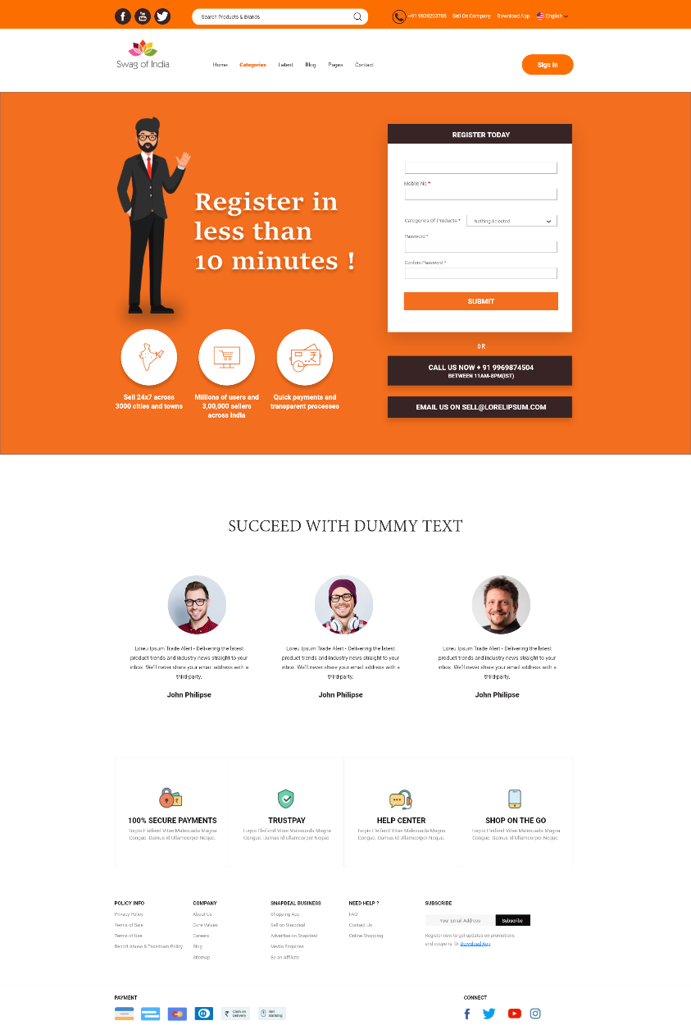
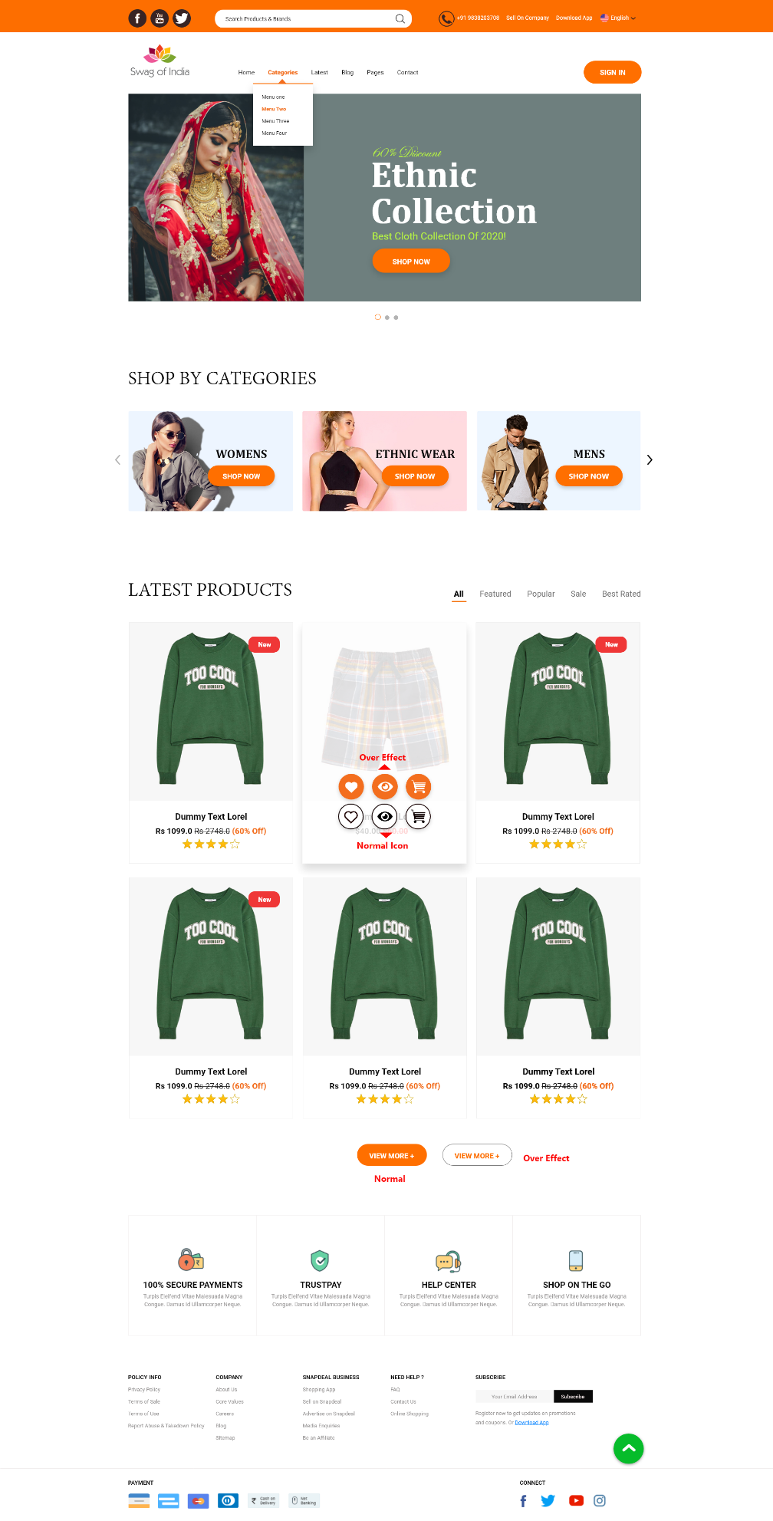
Mockup
Notes:
Ui-patterns.com
Dribbble.com
Balsamiq if want to do wireframing professionally
Now implement each feature of your wireframe using the bootstrap components from its documentation.

Slide 9
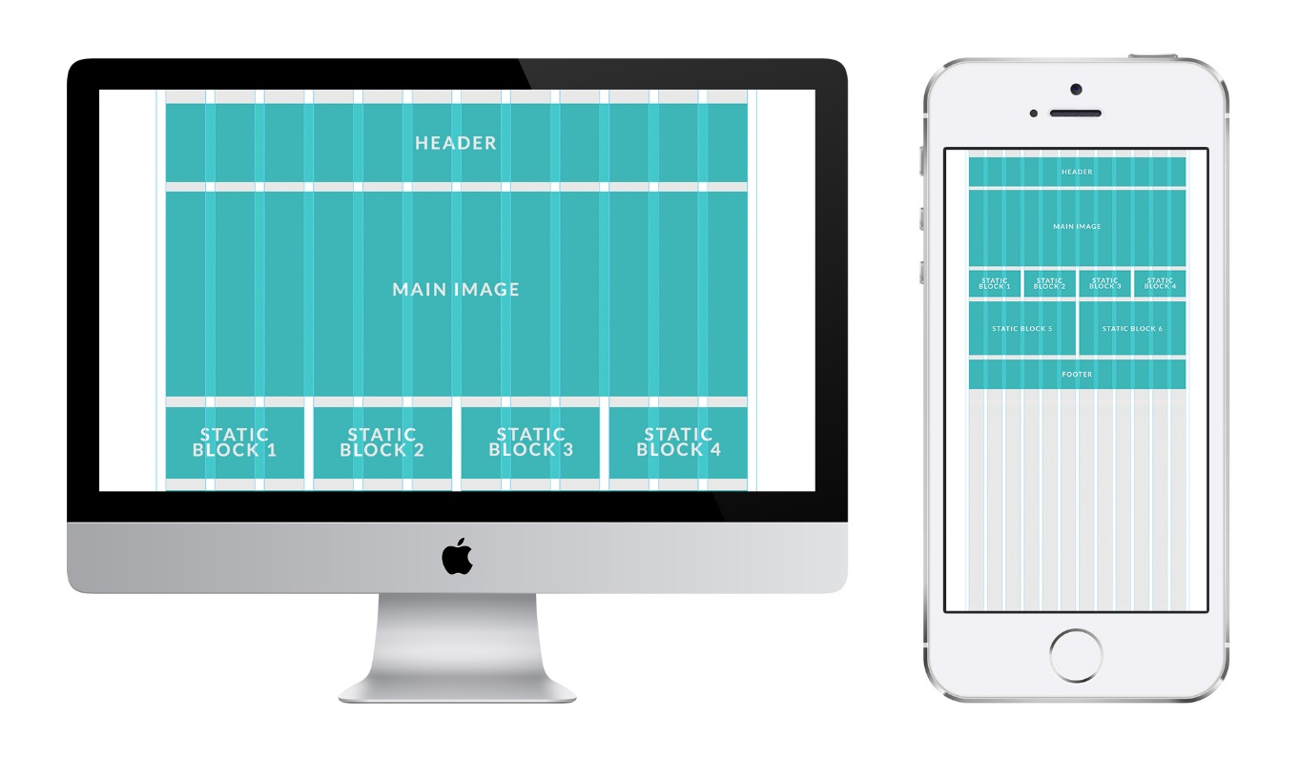
Twitter Bootstrap- Grid System
Notes:
<div class = "container"> <div class = "row"> <div class = "col-*-*"></div> <div class = "col-*-*"></div> </div> <div class = "row">...</div> </div>
All columns must be inside row.
.row has negative margin to counteract the 15px default padding of .container for correct alignment of everything.
Col-md-span- md- screen width range identifier, remember the range of px of large medium and small devices. Span- number of columns are spanned.

Slide 10
Grid system
.col- (< 576px)
.col-sm- (> 576px)
.col-md- (> 768px)
.col-lg- (> 992px)
.col-xl- (>1200px)
Notes:
Grid layout in bootstrap is based on floating elements. So the clear property hack for bootstrap is- responsive column resets, add an extra div for every row, class clearfix and visible only to whatever device layout which is problematic.
Clearfix- important in bootstrap grid for overflowing things out of grid system layout visual.

Slide 11
Bootstrap containers
.container
.container-fluid
Notes:
Containers
Bootstrap 4 also requires a containing element to wrap site contents.
There are two container classes to choose from:
The .container class provides a responsive fixed width container
The .container-fluid class provides a full width container, spanning the entire width of the viewport
By default, containers have 15px left and right padding, with no top or bottom padding. Therefore, we often use
spacing utilities, such as extra padding and margins to make them look even better. For example, .pt-3 means "add a top padding of 16px" <div class="container pt-3"></div>
In VS code, do div.container and tab so it gives div class container code.

Slide 12
Clearfix
Important in bootstrap grid when things are overflowing out of grid system visual layout.
Quickly and easily clears floated content within a container.
<div class="clearfix">...</div>
Notes:
https://getbootstrap.com/docs/4.0/utilities/clearfix/

Slide 13
Other Bootstrap components
Badges
list groups
Collapse
Wells
Popover
Toast
Scrollspy
Utilities
Notes:
Bootstrap classes- navbar brand, pull left, visible lg/ md etc, navbar toggle code in bootstrap eg, sr-only screen readr olhy,
Class text-center in bootstrap
Links- Bootstrap class active for active li or link.
HTML 5 api provides data-toggle, data-target etc api for js usage easy.

Slide 14
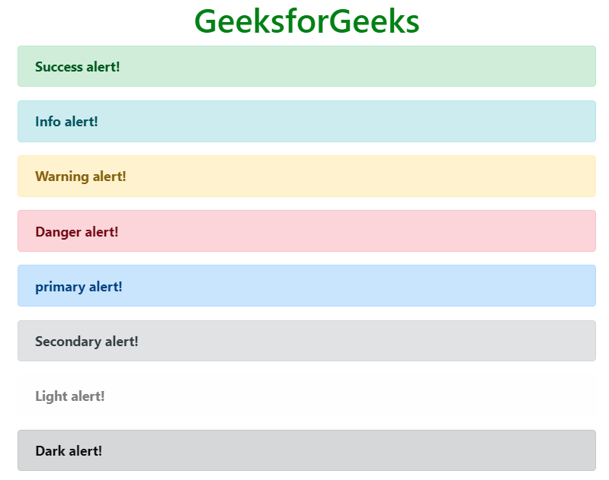
Animated Alerts
Notes:
<div class="alert alert-danger alert-dismissible fade show">

Slide 15
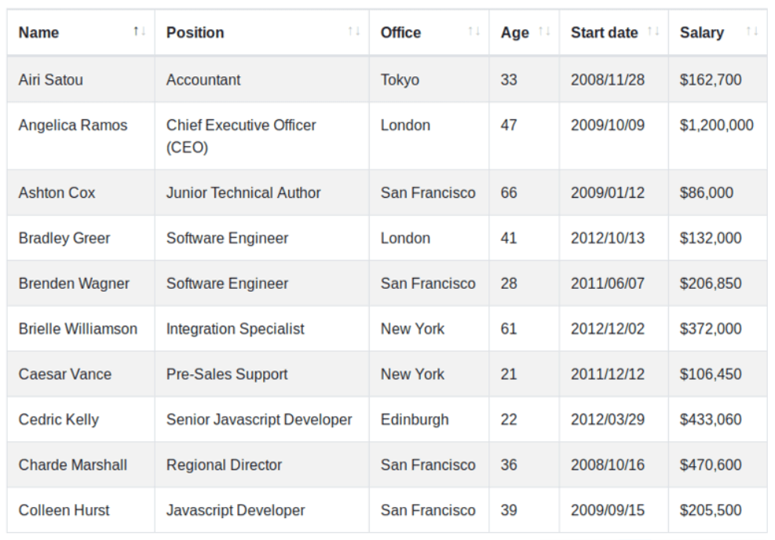
Bootstrap tables

Slide 16
Image
The .img-fluid class applies max-width: 100%; and height: auto; to the image
Float an image to the right/left with the .float-right/.float-left
The .rounded-circle shapes the image to a circle
The .rounded adds rounded corners to an image
Jumbotron
.img-responsive class
Notes:
as width of the browser changes, the width and size of img changes proportionally.

Slide 17
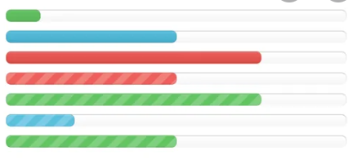

Progress bars and spinners
Animated Progress Bar
Spinner Buttons
Spinners
.spinner-border
.spinner-grow.
smaller spinner
.spinner-border-sm
.spinner-grow-sm
Use any text color utilites to add a color to the spinner
Notes:
<div class="progress-bar progress-bar-striped progress-bar-animated" style="width:40%"></div>
<button class="btn btn-primary"> <span class="spinner-border spinner-border-sm"></span> Loading.. </button>
<div class="spinner-border text-primary"></div>

Slide 18
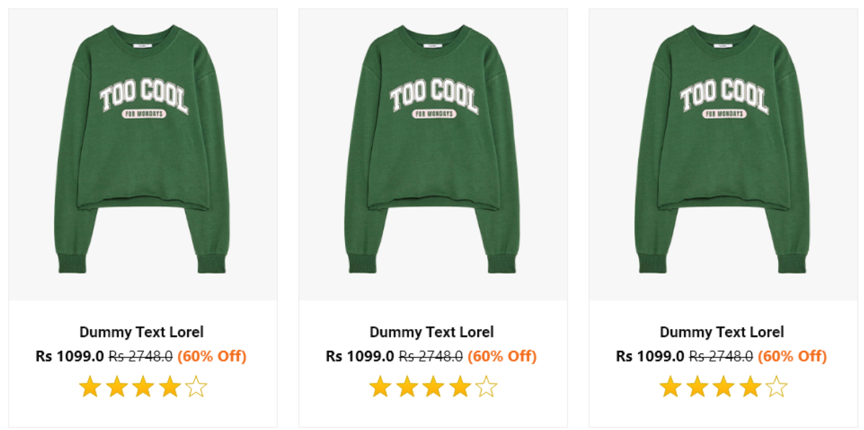
Bootstrap cards
Notes:
Create product cards for your ecommerce site

Slide 19


Slide 20

Bootstrap carousels
Notes:
Create a bootstrap carousel for ecommerce site

Slide 21
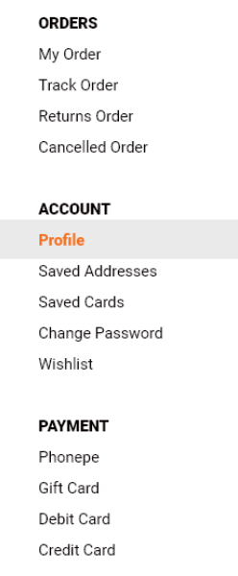
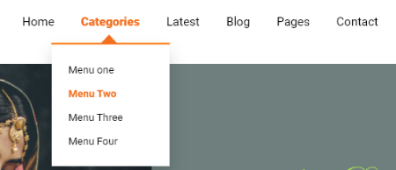
Bootstrap navigation bars
Notes:
Create navigation bars for the ecommerce website

Slide 22
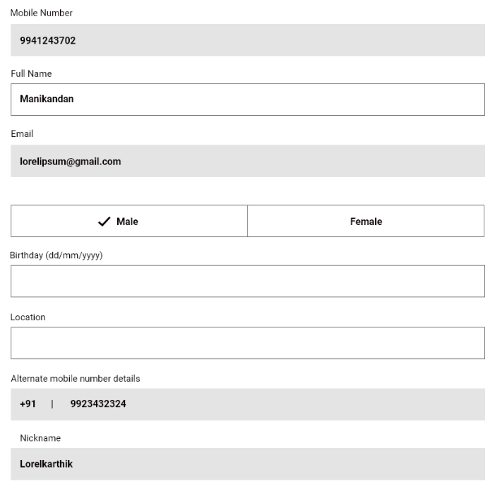
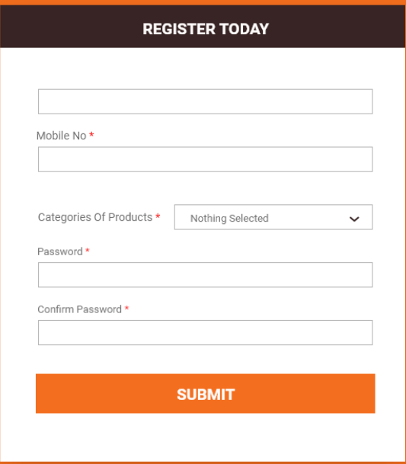
Bootstrap form
Notes:
Create a complain form in your ecommerce website and other forms using-
https://codepen.io/lentilz/pen/ivhcx
https://codepen.io/suez/pen/RpNXOR
https://bootsnipp.com/snippets/dlZAN

Slide 23
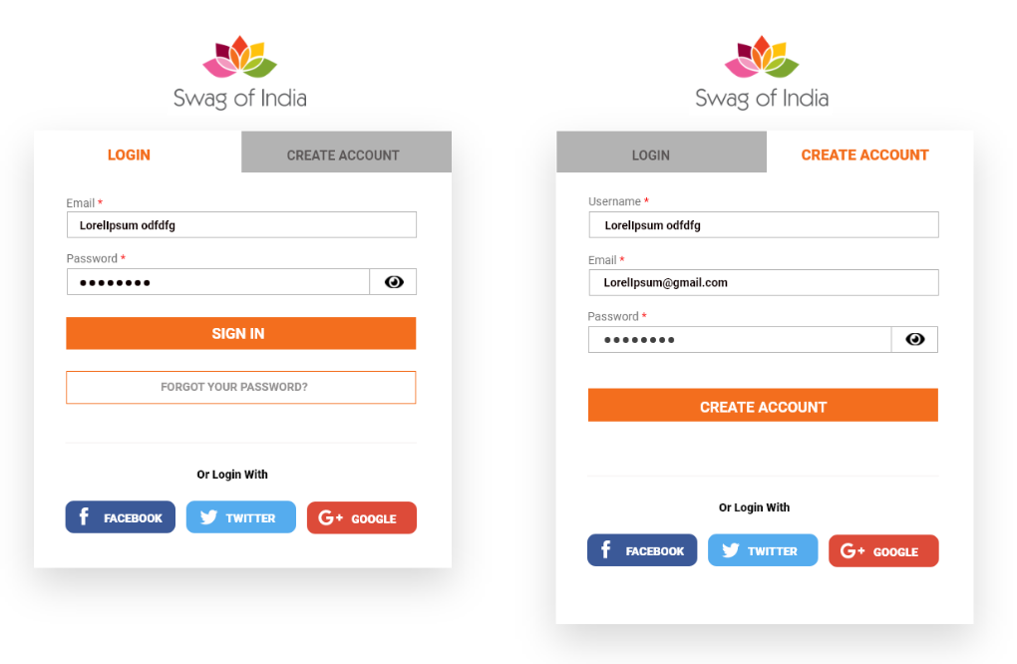
Modals

Slide 24
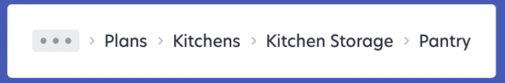
Breadcrumb

Slide 25
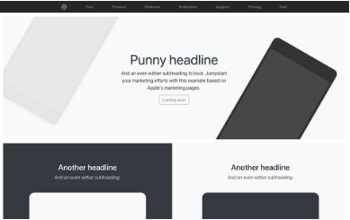
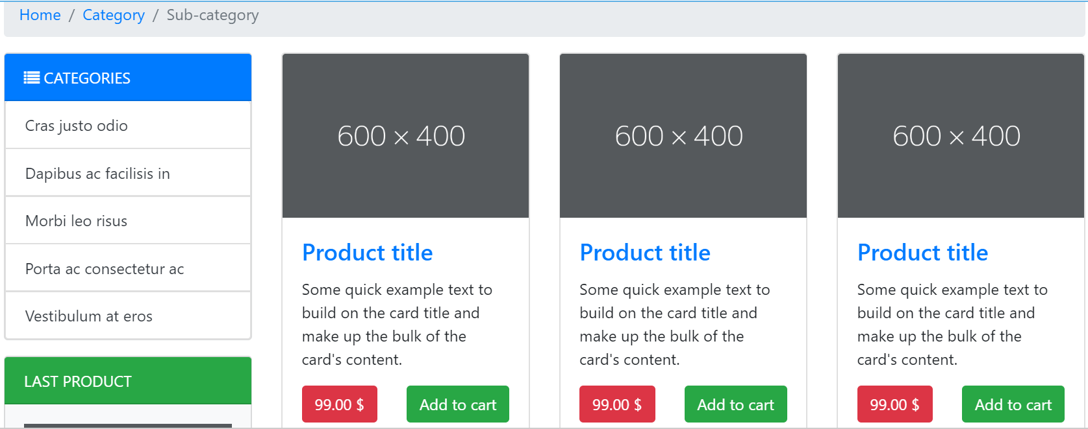
Bootstrap Themes
Ecommerce website pages idea
Custom components
Notes:
Also check bootsnipp.com
Pixel perfect- https://medium.com/pixelpoint/handoffs-guide-for-pixel-perfect-design-part-ii-d91999742dd9
https://bootsnipp.com/search?q=ecommerce
Ecommerce website pages idea https://bootsnipp.com/search?q=ecommerce
Custom components-https://getbootstrap.com/docs/4.0/examples/

Slide 26
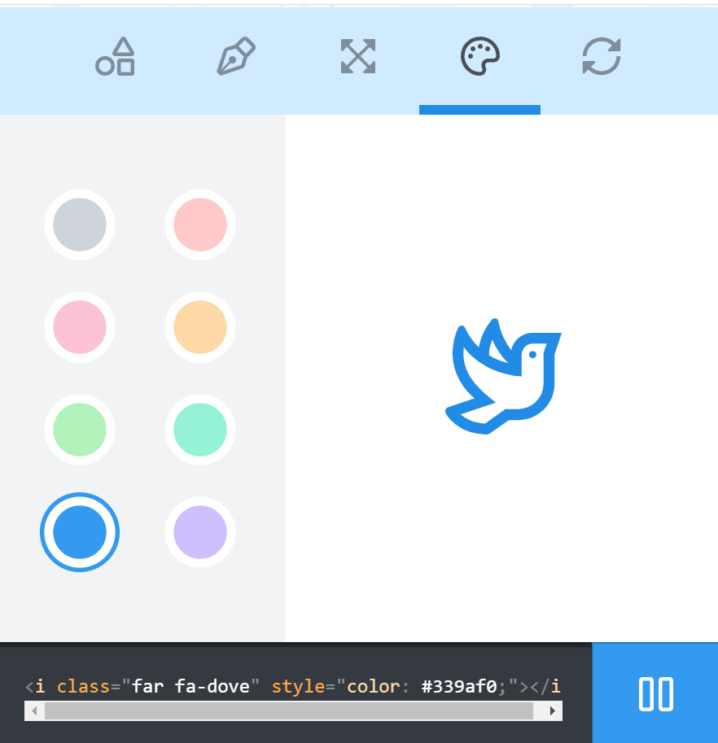
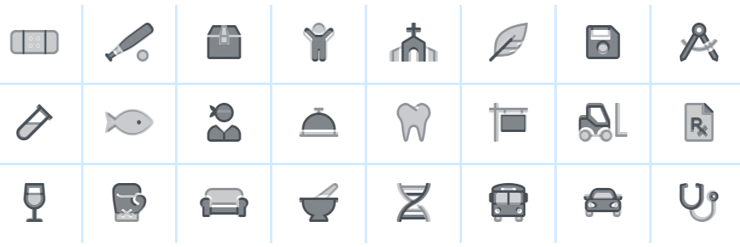
Font Awesome
Pixel perfect, fully responsive icons and fonts.
Notes:
<link rel="stylesheet" href="https://use.fontawesome.com/releases/v5.7.0/css/all.css" integrity="sha384-lZN37f5QGtY3VHgisS14W3ExzMWZxybE1SJSEsQp9S+oqd12jhcu+A56Ebc1zFSJ" crossorigin="anonymous">

Slide 27
Code refactoring
After every iteration or feature addition, check for need of refactoring code.
Follow DRY, readability, modularity, efficiency, length and separation of concerns principles.

Slide 28
Best practices
Use IDs for all sections of your web page for having links to them directly. Specially for SPAs
Never change the bootstrap code files. Add custom classes and use specificity to help you.
If you need to create your own style like bootstrap with minor modifications, then go to bootstrap.css and copy from there.
If you don’t need further containers, then don’t make new divs, rather make sections.
Have different resolutions and sizes for the images to use on different sizes of screen.

Slide 29
Summary
Mobile first paradigm
Including Bootstrap
Wireframes, Mockups
Bootstrap Grid system
Other Bootstrap components
Font Awesome
Refactoring
Best practices

Slide 30
Motivational tip
You have really come a long way than from where you started.
Think- what are the dreams you wish to achieve?
Do you even know what can be possibly achieved? Whether your dream is even big enough?
Now think- how much would you like to sacrifice to gain them?
Notes:
Know what you can achieve in your career as a software developer/front end engineer.
What are the perks which companies like google, amazon, cisco gives to their engineers. Know from others working there and from online influencers.
Dream big!

Slide 31
Assignment
Use the Bootstrap framework to correct responsiveness issues in the webpage provided to you
Add a carousel for the main photo slider.
Add a hamburger for small devices in navigation menu.
Add descriptive comments for everything you implement.

Slide 32
Answer the following Questions
What are Offset columns?
How can you change the order of columns in Bootstrap?
What is Normalize in Bootstrap?
What is affix plugin?
How will you create a tabbed, pills, and vertical pills navigation menu in Bootstrap?
How do you create and customize thumbnails in Bootstrap?
Please explain Bootstrap alerts. Also, tell how you will create a Bootstrap Dismissal Alert.
What do you understand by Bootstrap media objects?

